Slide 1

Dr. Hesam Chiniforooshan
se.usc.ac.ir@gmail.com

Slide 2


Your university needs a learning management system. You are hired as a consultant software engineer.
Notes:
No noodle

Slide 3

What is a Software?
  Computer programs and associated documentation such as requirements, design models and user manuals.
  Software products may be
    Generic - developed to be sold to a range of different customers e.g. PC software such as Excel or Word.
    Bespoke (custom) - developed for a single customer according to their specification.
[Sommerville: Software Engineering]
  Software is:
    Instructions (computer programs) that when executed provide desired features, function, and performance;
    Data structures that enable the programs to adequately manipulate information
    Documentation that describes the operation and use of the programs.
[Pressman – Software Engineering: Practitioners’ Approach]
Notes:
Hopefully you have an idea of what a software is !!
Can a brave lady or gentleman define Software for me?
By saying that it is a PRODUCT, immediately it comes to mind that it needs a development line for its engineering, design, development, marketing, support, shipment, installation, specification, advertising, . . .

Slide 4

Software’s Dual Role
  Software is a product
    Delivers computing potential
    Produces, manages, acquires, modifies, displays, or transmits information
  Software is a vehicle for delivering a product
    Supports or directly provides system functionality
    Controls other programs (e.g., an operating system)
    Effects communications (e.g., networking software)
    Helps build other software (e.g., software tools)
[Pressman – Software Engineering: Practitioners’ Approach]
Notes:
Hopefully you have an idea of what a software is !!
Can a brave lady or gentleman define Software for me?
By saying that it is a PRODUCT, immediately it comes to mind that it needs a development line for its engineering, design, development, marketing, support, shipment, installation, specification, advertising, . . .

Slide 5

What is Software Engineering?
  The IEEE Computer Society defines software engineering as: “
    (1) The application of a systematic, disciplined, quantifiable approach to the development, operation, and maintenance of software; that is, the application of engineering to software.
    (2) The study of approaches as in (1)
Software engineering is concerned with theories, methods and tools for professional software development. [Sommerville: Software Engineering]
Notes:
Is it really an engineering discipline?
SE vs Coder

Slide 6

More and more, individuals and society rely on advanced software systems. We need to be able to produce reliable and trustworthy systems economically and quickly.
It is usually cheaper, in the long run, to use software engineering methods and techniques for software systems rather than just write the programs as if it was a personal programming project. For most types of system, the majority of costs are the costs of changing the software after it has gone into use.
[Sommerville: Software Engineering]

Slide 7

Software costs often dominate computer system costs. The costs of software on a PC are often greater than the hardware cost.
Software costs more to maintain than it does to develop. For systems with a long life, maintenance costs may be several times development costs.
Software engineering is concerned with cost-effective and quality software development.
[Sommerville: Software Engineering]

Slide 8
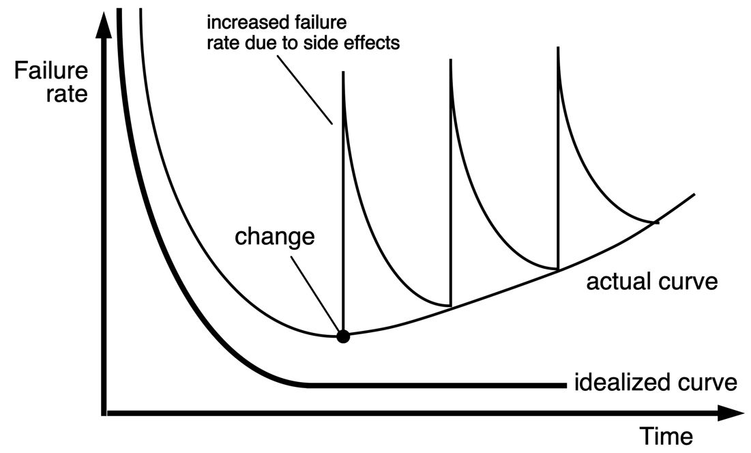

Slide 9

ISO/IEC 9126 (Software engineering — Product quality )
  Functionality - A set of attributes that bear on the existence of a set of functions and their specified properties. The functions are those that satisfy stated or implied needs.
    Suitability; Accuracy; Interoperability; Security; Functionality Compliance
  Reliability - A set of attributes that bear on the capability of software to maintain its level of performance under stated conditions for a stated period of time.
    Maturity; Fault Tolerance; Recoverability; Reliability Compliance
  Usability - A set of attributes that bear on the effort needed for use, and on the individual assessment of such use, by a stated or implied set of users.
    Understandability (Learnability; Operability; Attractiveness; Usability Compliance)
  Efficiency - A set of attributes that bear on the relationship between the level of performance of the software and the amount of resources used, under stated conditions.
    Time Behaviour; Resource Utilisation; Efficiency Compliance
  Maintainability - A set of attributes that bear on the effort needed to make specified modifications.
    Analyzability; Changeability; Stability; Testability; Maintainability Compliance
  Portability - A set of attributes that bear on the ability of software to be transferred from one environment to another.
    Adaptability; Installability; Co-Existence; Replaceability; Portability Compliance)

Slide 10

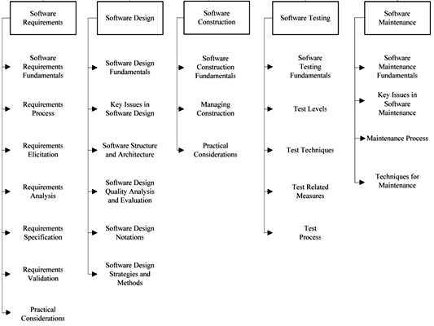

Slide 11
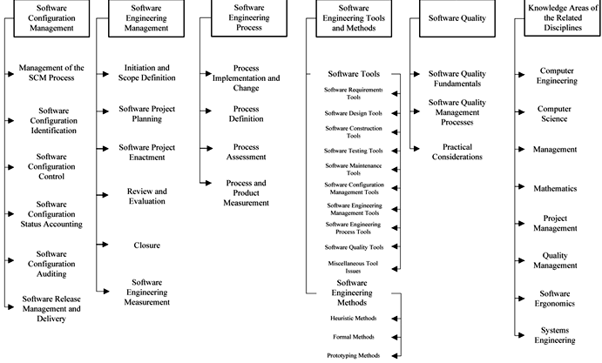

Slide 12
An engineering discipline which is concerned about all aspects of software production [Sommerville]
  Process Aspect
    Managers: Process improvement is the key to success
  Product Aspect
    Programmers: “You don’t sell processes, you sell code”
  Software engineers should adopt a systematic and organised approach to their work and use appropriate tools and techniques depending on the problem to be solved, the development constraints and the resources available.
More than a discipline or a body of knowledge: It is a way of approaching a problem [Scot Whitmire]
Software Engineering is a:
  Modeling Activity
    SE deals with complexity through modeling, as in different stages of development builds various models of the problems domain and solution domain
  Problem Solving Activity
    Models are used to search for an acceptable solution
  Knowledge Acquisition Activity
    In modeling problem and solution domain, software engineers collect data, organize it into information, and formalize it into knowledge.
  Rationale-Driven Activity
    Models of problem domains should capture the context in which decisions are made and the rationale behoind these decisions
  [Bruegge & Dutoit: Object-Oriented Software Engineering (2010)]

Slide 13

SE vs. Computer Science
  Computer science is concerned with theory and fundamentals;
  software engineering is concerned with the practicalities of developing and delivering useful software
SE vs. System Engineering
  System engineering is concerned with all aspects of computer based systems development including hardware, software and process engineering. Software engineering is part of this Process
  System engineers are involved in system specification, architectural design, integration and deployment
[Ian Sommerville: Software Engineering]

Slide 14

Software specification, where customers and engineers define the software that is to be produced and the constraints on its operation.
Software development, where the software is designed and programmed.
Software validation, where the software is checked to ensure that it is what the customer requires.
Software evolution, where the software is modified to reflect changing customer and market requirements.
We will review software processes in upcoming lectures in detail

Slide 15

Heterogeneity
  Increasingly, systems are required to operate as distributed systems across networks that include different types of computer and mobile devices.
Business and social change
  Business and society are changing incredibly quickly as emerging economies develop and new technologies become available. They need to be able to change their existing software and to rapidly develop new software.

Slide 16
Security and trust
  As software is intertwined with all aspects of our lives, it is essential that we can trust that software.
Scale
  Software has to be developed across a very wide range of scales, from very small embedded systems in portable or wearable devices through to Internet-scale, cloud-based systems that serve a global community.
Chapter 1 Introduction
30/10/2014

Slide 17


Same problem …

Slide 18

Software engineering involves wider responsibilities than simply the application of technical skills.
Software engineers must behave in an honest and ethically responsible way if they are to be respected as professionals.
Ethical behaviour is more than simply upholding the law.
[Ian Sommerville: Software Engineering]

Slide 19

Confidentiality
  Engineers should normally respect the confidentiality of their employers or clients irrespective of whether or not a formal confidentiality agreement has been signed.
Competence
  Engineers should not misrepresent their level of competence. They should not knowingly accept work which is out with their competence.

Slide 20
Intellectual property rights
  Engineers should be aware of local laws governing the use of intellectual property such as patents, copyright, etc. They should be careful to ensure that the intellectual property of employers and clients is protected.
Computer misuse
  Software engineers should not use their technical skills to misuse other people’s computers. Computer misuse ranges from relatively trivial (game playing on an employer’s machine, say) to extremely serious (dissemination of viruses).

Slide 21

The professional societies in the US have cooperated to produce a code of ethical practice.
Members of these organisations sign up to the code of practice when they join.
The Code contains eight Principles related to the behaviour of and decisions made by professional software engineers, including practitioners, educators, managers, supervisors and policy makers, as well as trainees and students of the profession.

Slide 22

Preamble
  The short version of the code summarizes aspirations at a high level of the abstraction; the clauses that are included in the full version give examples and details of how these aspirations change the way we act as software engineering professionals. Without the aspirations, the details can become legalistic and tedious; without the details, the aspirations can become high sounding but empty; together, the aspirations and the details form a cohesive code.
  Software engineers shall commit themselves to making the analysis, specification, design, development, testing and maintenance of software a beneficial and respected profession. In accordance with their commitment to the health, safety and welfare of the public, software engineers shall adhere to the following Eight Principles:

Slide 23

PUBLIC
  Software engineers shall act consistently with the public interest.
CLIENT AND EMPLOYER
  Software engineers shall act in a manner that is in the best interests of their client and employer consistent with the public interest.
PRODUCT
  Software engineers shall ensure that their products and related modifications meet the highest professional standards possible.

Slide 24
JUDGMENT
  Software engineers shall maintain integrity and independence in their professional judgment.
MANAGEMENT
  Software engineering managers and leaders shall subscribe to and promote an ethical approach to the management of software development and maintenance.
PROFESSION
  Software engineers shall advance the integrity and reputation of the profession consistent with the public interest.

Slide 25
COLLEAGUES
  Software engineers shall be fair to and supportive of their colleagues.
SELF
  Software engineers shall participate in lifelong learning regarding the practice of their profession and shall promote an ethical approach to the practice of the profession.
  ACM /IEEE Software Engineering Code of Ethics and Professional Practices https://ethics.acm.org/code-of-ethics/software-engineering-code/

Slide 26

Ian Sommerville: Software Engineering, Addison Wesley
Bruegge & Dutoit: Object-Oriented Software Engineering, Prentice Hall
Pressman Software Engineering: Practitioners’ Approach, McGraw-Hil
Software Engineering Body of Knowledge (SEBOK) http://www.computer.org/portal/web/swebok/htmlformat
ISO/IEC 9126 , Software engineering — Product quality
  ACM /IEEE Software Engineering Code of Ethics and Professional Practices

